Slide 1
LUIS
Notes:
We will go quickly through these slides, as it should be mostly a review of yesterday

Slide 2
Why NLU?
Rise of conversation-based applications
Need to extract meaning from context
Problem
We are not all data scientists, but we all need to be able to integrate NLU into our applications
Background
Notes:
Understanding NLU Stanford presentation: https://nlp.stanford.edu/~wcmac/papers/20140716-UNLU.pdf
Wikipedia: https://en.wikipedia.org/wiki/Natural_language_understanding
Why chatbots won’t survive without NLU: https://chatbotsmagazine.com/why-chatbots-wont-survive-without-nlu-df3670e911c5

Slide 3
Microsoft's Language Understanding Intelligent Service (LUIS)
A machine learning-based service to build natural language understanding into apps, bots, and IoT devices
Quickly create enterprise-ready, custom models that continuously improve
Can configure with a rich UI or programmatically
Background
Notes:
LUIS whitepaper: https://www.microsoft.com/en-us/research/wp-content/uploads/2016/02/sigdial2015demo.pdf
https://www.luis.ai/

Slide 4
Developing LUIS Models
Intents
Utterances
Entities
Training and testing
Publishing
Features/Patterns
Active learning

Slide 5
Key LUIS concepts
Intents
Actions the user wants to perform
Utterances
Text input from a user your app needs to understand
Entities
Detailed information that is relevant to the utterance
Intent | Sample user utterance | Entities
BookFlight | “Book a flight to Seattle?” | Seattle
StoreHoursAndLocation | “When does your store open?” | open
ScheduleMeeting | “Schedule a meeting at 1PM with Bob in Distribution” | 1PM, Bob
Developing LUIS models
Notes:
1. https://docs.microsoft.com/en-us/azure/cognitive-services/luis/home

Slide 6
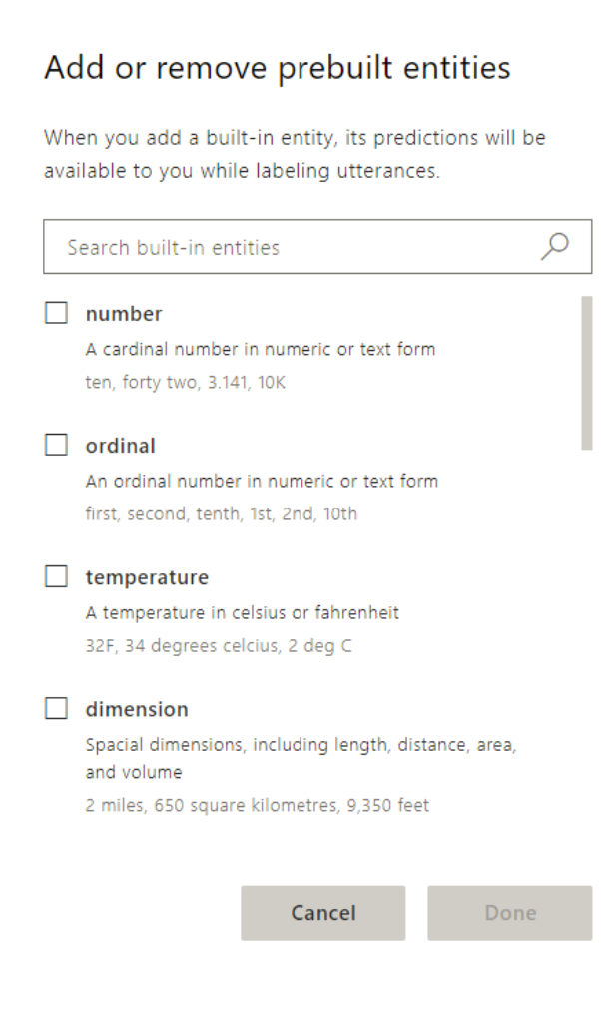
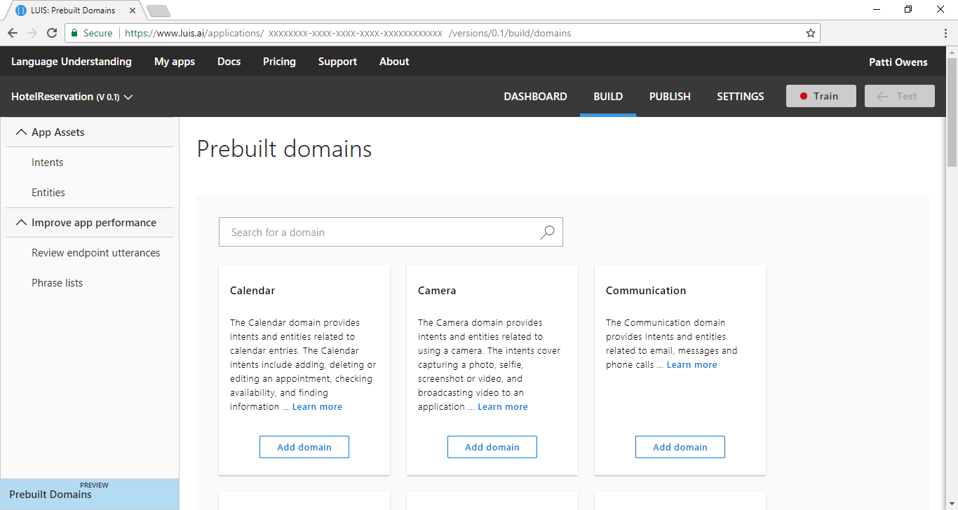
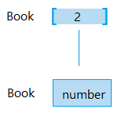
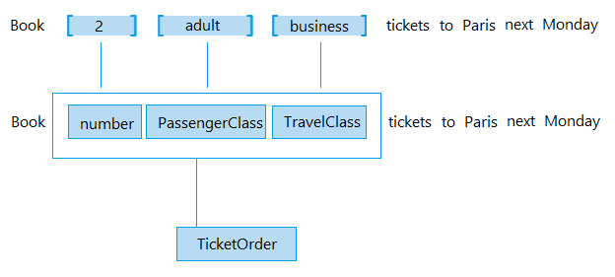
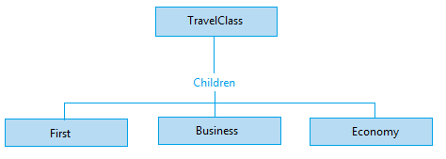
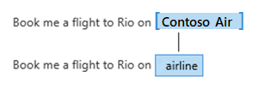
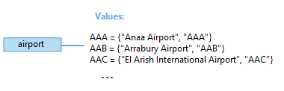
Key LUIS concepts
Simple entities
Hierarchical entities
Composite entities
Prebuilt entities
List entities
Developing LUIS models
Notes:
Plan your app: https://docs.microsoft.com/en-us/azure/cognitive-services/luis/plan-your-app
Prebuilt entity: https://docs.microsoft.com/en-us/azure/cognitive-services/luis/pre-builtentities
Prebuilt domains: https://docs.microsoft.com/en-us/azure/cognitive-services/luis/luis-how-to-use-prebuilt-domains
Best practices: https://docs.microsoft.com/en-us/azure/cognitive-services/luis/luis-concept-best-practices#entities
Recognizer-Texts, code behind prebuilt entities: https://blog.botframework.com/2018/01/24/contributing-luis-microsoft-recognizers-text-part-1/

Slide 7
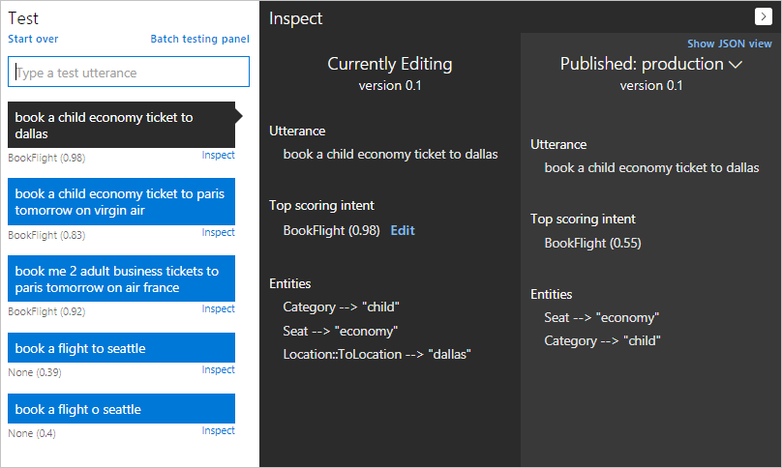
Training and testing your model
Developing LUIS models
Notes:
Train your model: https://docs.microsoft.com/en-us/azure/cognitive-services/luis/luis-how-to-train
Interactive testing: https://docs.microsoft.com/en-us/azure/cognitive-services/luis/train-test
Batch testing: https://docs.microsoft.com/en-us/azure/cognitive-services/luis/luis-how-to-batch-test

Slide 8
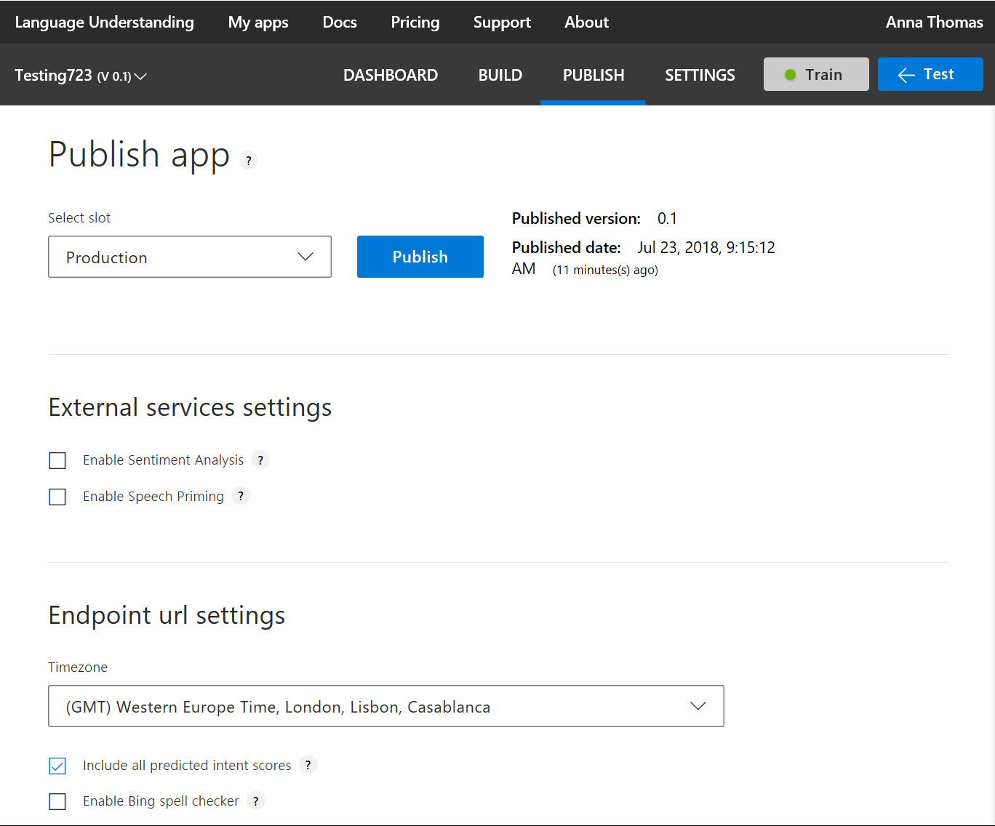
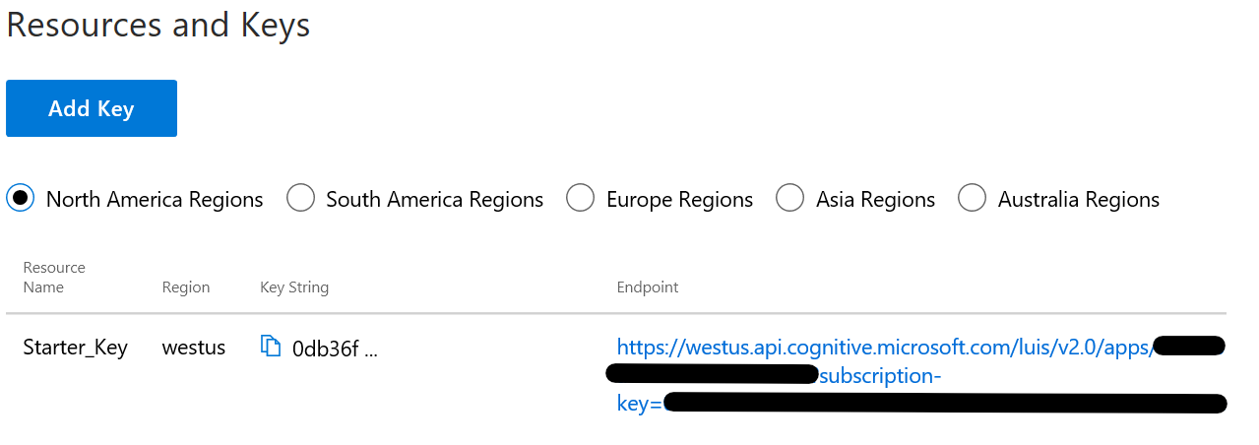
Publishing your model
Developing LUIS models
Notes:
1. Publish your model: https://docs.microsoft.com/en-us/azure/cognitive-services/luis/publishapp

Slide 9
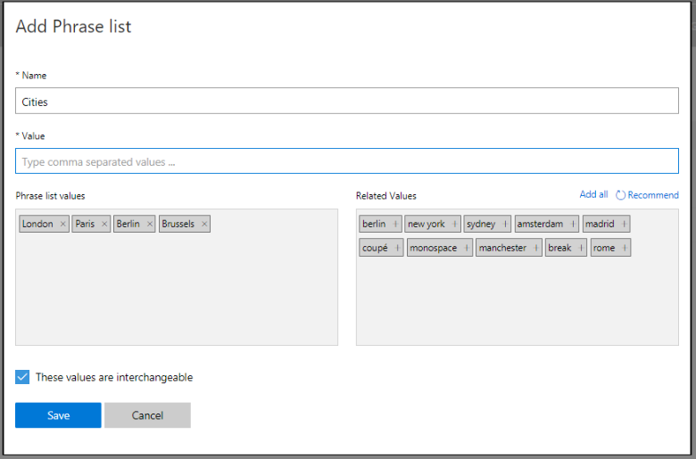
Adding features to improve performance
Features help LUIS by providing hints that certain words and phrases are part of a category
Developing LUIS models
Notes:
Add features: https://docs.microsoft.com/en-us/azure/cognitive-services/luis/add-features
10 phrase list must-haves blog: https://blogs.msdn.microsoft.com/benjaminperkins/2016/12/07/top-10-must-have-phrase-list-features-for-your-chatbot-or-any-bot-luis/

Slide 10
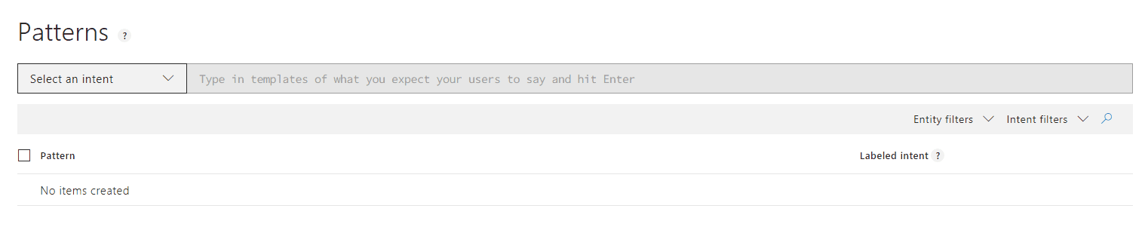
Adding patterns to improve performance
Patterns are template utterances with placeholders for entities used to further improve your model
Developing LUIS models
Notes:
Authoring cycle: https://docs.microsoft.com/en-us/azure/cognitive-services/luis/luis-concept-app-iteration
Label endpoint utterances: https://docs.microsoft.com/en-us/azure/cognitive-services/luis/label-suggested-utterances

Slide 11
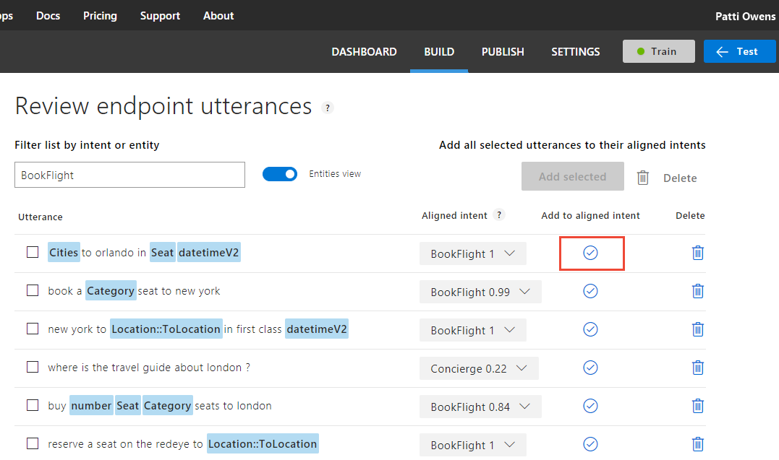
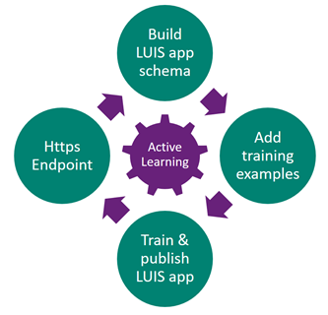
Using active learning
Developing LUIS models
Notes:
Authoring cycle: https://docs.microsoft.com/en-us/azure/cognitive-services/luis/luis-concept-app-iteration
Label endpoint utterances: https://docs.microsoft.com/en-us/azure/cognitive-services/luis/label-suggested-utterances

Slide 12
9-9:45AM https://github.com/Azure/LearnAI-Airlift and check out my blog if you finish early ☺ https://aka.ms/luis-notes
Lab 5: LUIS

